Slide 1
Topic 4 Association Rules
What is Association Rules?
How does Association Rules work?
Points of consideration for Association Rules.
When do you use Association Rules.
Advantages of Association Rules
Disadvantages of Association Rules

Slide 2
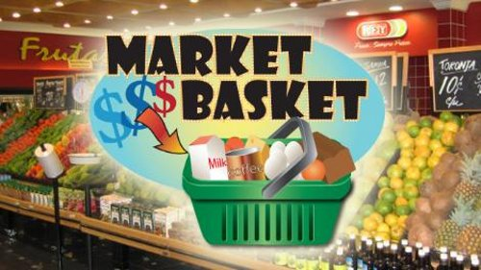

Slide 3
What is Association Rules?
Association Rules is a modelling technique based upon the theory that if you buy a certain group of items, you are more (or less) likely to buy another group of items.
Goal of MBA
The goal of Association Rules (MBA) is to determine which items tend to be purchased together.

Slide 4
Purposes of Association Rules
Visualize the degree of attraction between items.
View charts representing item associations, rank association rules.
Understand customer purchasing patterns.
Predict the likelihood of a customer response.
Optimize your marketing and sales operations.
Others

Slide 5
Association Rules
6 ways to get most out of Association Rules
http://youtu.be/iZ0h5bWo_sk

Slide 6
MBA is applied to transaction data
MBA data mining technique, unlike other data mining techniques, is applied directly to transactional data.

Slide 7
Co-occurrence Table
MBA analyzes the items bought by customers.
How items are paired together?
=> a co-occurrence table.
A co-occurrence table shows the number of times that any pair of items was purchased together.

Slide 8
Figure 1: Five transactions in a grocery store and there are five Items bought by customers
Transaction | Item
1 | Apple Juice, Pepsi
2 | Milk, Apple Juice, Ice Cream
3 | Apple Juice, Detergent
4 | Apple Juice, Detergent, Pepsi
5 | Ice Cream, Pepsi

Slide 9
The five products are:
Milk,
Apple Juice,
Ice Cream,
Detergent,
Pepsi

Slide 10
Figure 2: A co-occurrence table of items (refer to Figure 1)
A Co-occurrence table of items indicate the number of times pair of Items was purchased.
 | AJ | IC | MK | PI | DG
AJ | 4 | 1 | 1 | 2 | 2
IC | 1 | 2 | 1 | 1 | 0
MK | 1 | 1 | 1 | 0 | 0
PI | 2 | 1 | 0 | 3 | 1
DG | 2 | 0 | 0 | 1 | 2

Slide 11
Question 1
1. Recommend pairing of items.
(refer to figure 2)
You may recommend 4 bundles.
2. Will you bundle ice cream and detergent? If not, why ?

Slide 12
Example of a Rule
Association Rules seeks to find relationships between purchases.
Typically the relationship will be in the form of a rule:
Rule: Pepsi ➔Apple Juice
(read as IF {Pepsi} THEN {Apple Juice})

Slide 13
How Good is the rule? Pepsi ➔Apple Juice
To determine how good a rule is, one has to compute 3 measures:
Support of the rule
Confidence of the rule
Lift of the rule

Slide 14
Support for Rule: Pepsi ➔Apple Juice
Support for an association rule
is the number or percentage of transactions containing items found in both the antecedent (condition) and the consequent (result)
What is the number of times the combination
(Pepsi ,Apple Juice) occurs?
2 transactions out of a total 5 transactions
Expressed in percentage = 40%

Slide 15
Support for Rule: Pepsi ➔Apple Juice
Can be expressed as a probability or percentage
P (Pepsi ,Apple Juice)= 0.4 (40%)

Slide 16
Confidence for Rule: Pepsi ➔Apple Juice
Confidence of an association rule is the
percentage of transactions
containing the antecedent (condition)
that also contain the consequent (result)
Let’s express the above as a formula

Slide 17
Confidence Formula = for Rule: Pepsi ➔Apple Juice
= Number of transactions with all the items in the rule
Number of transactions with JUST the items in condition
= No. of transactions with combination: Pepsi and Apple Juice (2)
No. of transactions with JUST the items in condition: Pepsi(3)
Confidence of Rule: Pepsi ➔Apple Juice = 0.67 (67%)

Slide 18
Confidence Formula another way for Rule: Pepsi ➔Apple Juice
= P (Condition & Result )
P (Condition)
= P ( Pepsi, Apple Juice )
P (Pepsi )
So need to know
P ( Pepsi, Apple Juice ) = 2/5
P (Pepsi ) = 3/5
= 2/3
= 0.67 (67%)

Slide 19
Interpretation
Support for Rule: Pepsi ➔Apple Juice = 40%
40% of the total transactions contains this combination of Pepsi and Apple Juice
Confidence of Rule: Pepsi ➔Apple Juice = 0.67 (67%)
67% of the customers who buy Pepsi also buy Apple Juice

Slide 20
Association Rule
(fish curry powder)&(coconut)&(chilli peppers) ➔(fish head)
Antecedent (condition)➔ Consequent (result)
Antecedent refers to what goes before…
A➔ B with 60% confidence
60% of the customers who buy fish curry powder, coconut, and chilli peppers also buy a fish head.

Slide 21
Confidence & Support
Confidence ➔60%
Support ➔ 30%
Confidence:
60% of customers who buy (fish curry powder, coconut and chilli peppers) also buy (fish head).
Support:
This pattern/combination occurs in 30% of all transactions.
Combination:
Fish curry powder, coconut and chilli peppers, fish head.

Slide 22
Question 2
If P (pencil + eraser) = 0.3, P (pencil) = 0.4 and P (eraser) = 0.8, the rule “If pencil then eraser”, what is the confidence value?
a) Support Value = ???
b) Confidence Value = ???
(express as percentage)

Slide 23
Lift
Lift value
tells us how much better a rule is at predicting the result than just assuming the result (random chance)
Lift = P (Condition & Result )
P (Condition) P (Result)

Slide 24
Lift value for Rule: Pepsi ➔Apple Juice
Lift = P (Condition & Result )
P (Condition) P (Result)
= P ( Pepsi, Apple Juice )
P (Pepsi ) P (Apple Juice)
= ___2/5___ = 5 < 1
3/5 x 4/5 6

Slide 25
How to interpret Lift value?
If the rule (butter) ➔ (bread) has a lift value of 3, a transaction containing butter is thrice as likely to contain bread than a randomly selected transaction

Slide 26
How to interpret Lift value?
Lift value > 1
The rule is better at predicting the result than random chance.
It represents positive correlation between LHS (condition part)and RHS(result part).
lift value < 1
The rule is worse off than random guessing.
It represents negative correlation between LHS and RHS. Negating the result produces a better rule.
lift value = 1
The rule is worse off then random guessing.
It represents independence between LHS and RHS

Slide 27
Question 3
Rule | Confidence | Lift
Rule 1: Car and Loan => Car Insurance | 0.60 | 2.11
Rule 2: Car and Car Insurance => Loan | 1 | 2.11
Rule 3: Car Insurance and Loan => Car | 1 | 1
a) Which two rules show high association?
b) Which is the worst rule? Please explain.
c) Recommend the best rule. Justify your choice.

Slide 28
Summarise 3 key measures
Purposes of Association Rules
Co-occurrence table of items
Support
Confidence
Lift

Slide 29
Let’s take a look at a combination of N items
N=3
3 items: A, B, C

Slide 30
Support for each Combination
Combination | Support (Probability) | Support (%)
A | 0.5 | 50
B | 0.45 | 45
C | 0.35 | 35
AB | 0.25 | 25
AC | 0.2 | 20
BC | 0.15 | 15
ABC | 0.05 | 5
Have I
exhausted
All possible
combinations?

Slide 31
Combination & Permutation
Concept of Combination
an arrangement of objects in which the order makes no difference.
Concept of Permutation:
an arrangement of objects in which the order makes a difference

Slide 32
Number of ways 2 items can be formed from a group of 3.
Way 1: AB
Way 2: AC
Way 3: BC
Way 4: BA
Way 5: CA
Way 6: CB
Is that all?
If order does NOT matter, then that’s all!
If order DOES matter,
then there’s 3 more ways – mirror image!

Slide 33
Permutation: If order matters,
How many ways can r items be formed from a group or n items
^{n}P_{r} = n! / (n-r)!
³P₂= 3! / (3-2)! = 6 ways
Note: 3! = 3*2*1 (3 factorial)
0! = 1

Slide 34
Combination: If order does not matter,
Way 1: AB
Way 2: AC
Way 3: BC
Way 4: BA
Way 5: CA
Way 6: CB
Do away with mirror image
If order does not matter then there are only
6 ways / 2 = 3 ways of forming 2 items from a group of 3

Slide 35
Combination: If order does not matter,
The number of combinations of n objects taken r at a time is denoted by ^{n}C_{r}. ^{n}C_{r} is read as “n chooses r”.
^{n}C_{r} = ^{n}P_{r} / ^{r}P_{r}
= _____n! ______
r! (n-r)!
³C₂ ⁼ _____________ ways

Slide 36
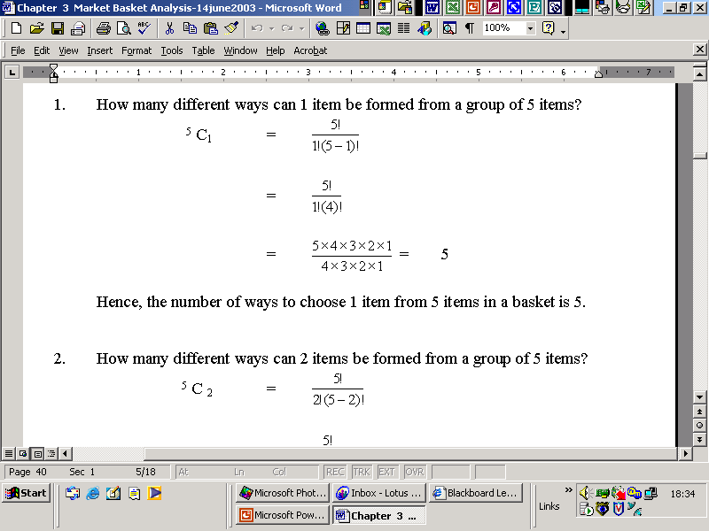
Combination

Slide 37
Question 3
There are 5 items: Apple Juice, Ice Cream, Pepsi, Orange and Milk?
List the different combination of 3 items.
How many ways can 3 items be formed from a group of five items?

Slide 38
Times Series
Taxonomy
Advantages
Disadvantages

Slide 39
Time Series Problem
Can be analyzed using MBA
Convert it into an MBA problem
Each time series is converted into a transaction by including the items
Before the event of interest or
After the event of interest and
Remove duplicate items from the transaction

Slide 40
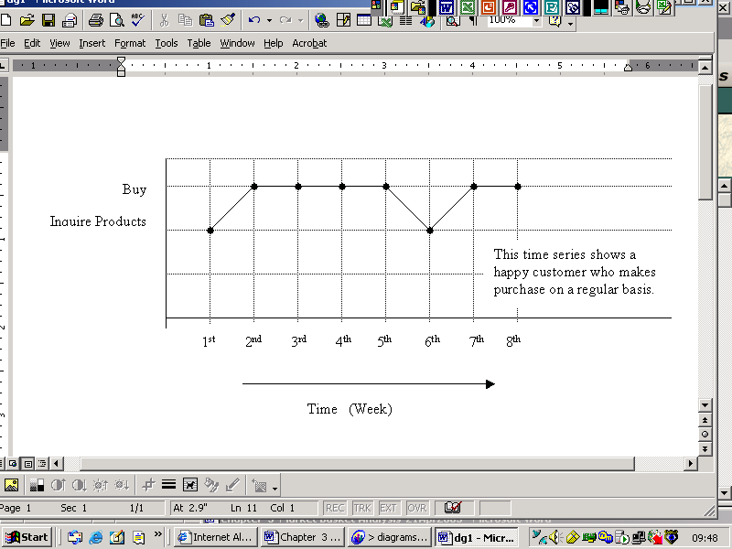
Happy Customer: [ Inquire Products, Buy]
Item: Event of Interest
Duplicate items
Item: Before Event of Interest

Slide 41
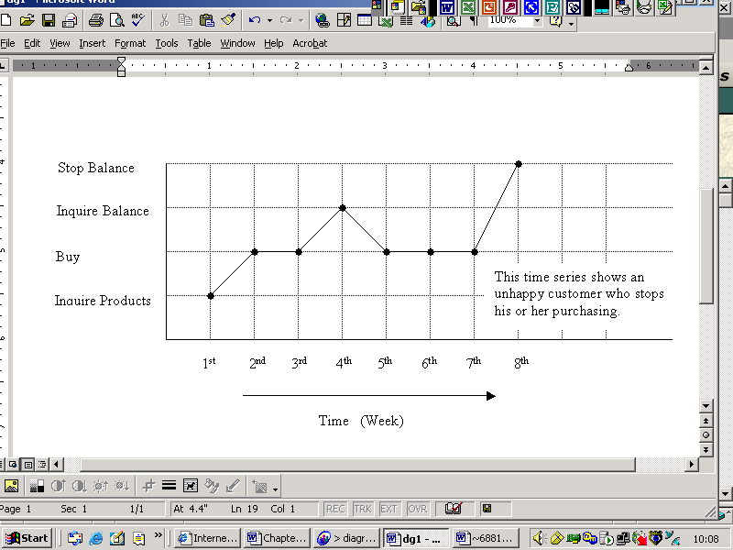
Unhappy customer: [inquire products, buy, inquire balance, stop balance]

Slide 42
Association Rules
Popular because of their simplicity and clarity
Generating rules is automatic, however
Hundreds or even thousands of rules may be generated, many are trivial or inexplicable.

Slide 43
Assess Association Rules
Sort Rules
Find Rules with high confidence/support
Beware High confidence does not imply a useful rule
100% buy car
A rule with 100% confidence with car as the result / consequent is useless

Slide 44
Select a Subset of Rules
Reduce the number of rules to analyze
Subset of rules based on
Confidence, support and lift
Number of items in the rules
Specific items in condition or result
Eg: look for rules with item under analysis in the result or condition

Slide 45
Definition of taxonomy
A taxonomy is an orderly hierarchy of items and item categories, dividing items such that each item put into the basket for analysis occurs with a similar level of support.

Slide 46
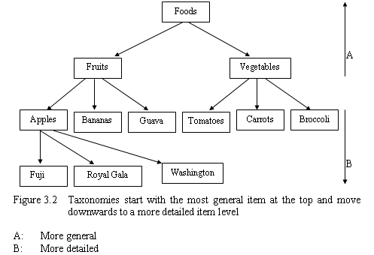
Taxonomies
Taxonomies

Slide 47
Taxonomies
If we are interested in rules includes Fruits,
Are we interested in Apples, Bananas, Guava? Or
Are we interested in a particular brand of fruits, Fuji, Royal Gala, Washington
Move items UP the taxonomy
to reduce the number of items
Move items DOWN the taxonomy
To produce more detailed rules
Different items can be at different levels

Slide 48
Summary of MBA

Slide 49
Confidence and Support
Confidence is a measure of how often the relationship holds true.
Support is a measure of how often the combination occurred overall.
Lift tells us how much better a rule at predicting the result than just assuming the result in the first place.

Slide 50
Lift
Lift = P(condition and result)
P(condition) P(result)
lift value > 1,
the resulting rule is better at predicting than random chance.
It represents positive correlation between LHS (condition part)and RHS(result part).

Slide 51
Lift
lift value < 1
it is worse off than random guess.
It represents negative correlation between LHS and RHS. Negating the result produces a better rule.
lift value = 1
it represents independence.

Slide 52
Sequential time-series analysis
time-series analyses on customers –
a way of tracking individual customers
A time series is an ordered sequence of items.
The time series contains identifying information about the customer.
The information is used to tie the different transactions together into a series.

Slide 53
From transactions to time series
Time series provide snapshots of two customers behaviour through time.
Strategy
To convert the time-series problem into a Association Rules problem.
Study the causes of an event that occurs at a particular time. Study the effects of an event.

Slide 54
Time windows
A time window is a snapshot of all items that occur within a certain time period.
The time-window use the following:
Happy customer: {inquire product, buy}
Unhappy customer: {inquire product, buy, inquire balance, stop buying}

Slide 55
Uses of Association Rules
It acts as starting point for further hypothesis testing.
It is used to compare sales during promotions versus sales at other times

Slide 56
Uses of MBA
MBA can be used for many other types of comparisons (cont):
To compare sales in various geographic areas, by country, standard statistical metropolitan area
To compare urban versus suburban sales
To detect seasonal differences in sales patterns.
eg Christmas, Chinese New Year

Slide 57
Advantages of Association Rules
The association rules could be translated into results easy to understand. You could generate SQL statements using “if-then” rules
The computations are simple for small number of items such as 5 items
It supports undirected data mining.

Slide 58
Disadvantages of Association Rules
It discounts rare items and expensive items
It is difficult to determine the right number of items
It requires exponentially more computational effort as the problem size grows.
It only understand how discrete items inter-relate with each other. It is not able to understand how continuous variables change over time.

Slide 59
Examples of applications
Analysis of credit card purchases.
Analysis of telephone calling patterns.
Identification of fraudulent medical insurance claims.
Analysis of telecom service purchases.

Slide 60
Review Questions (True/False)
MBA does not support undirected DM.
MBA uses the customer profile information to know what customers purchase to give us insight into who they are and why they buy certain items.
MBA is suitable for only directed DM style.
“If pencil, then eraser” has a confidence of 100 percent, it means that every transaction that contains pencil also contains eraser.
A rule consists of a condition and a result.
MBA does not produce any rules.

Slide 61
Review Questions
MBA considers items, which are rarely bought by customers.
A useful rule has a lift value that is greater than 1.
When the lift value is less than 1, the resulting rule is worst at predicting the result than random chance.
“If computer and printer then scanner” has a confidence of 0.45, then the rule “If computer and printer then NOT scanner” has a confidence of 1.

